Slide 1

IT8302
APPLIED MACHINE LEARNING CA1
Sng Tian Hao, Keith
1273381F
3 December 2024

Slide 2
TITANIC SURVIVORSHIP CLASSIFICATION

Slide 3
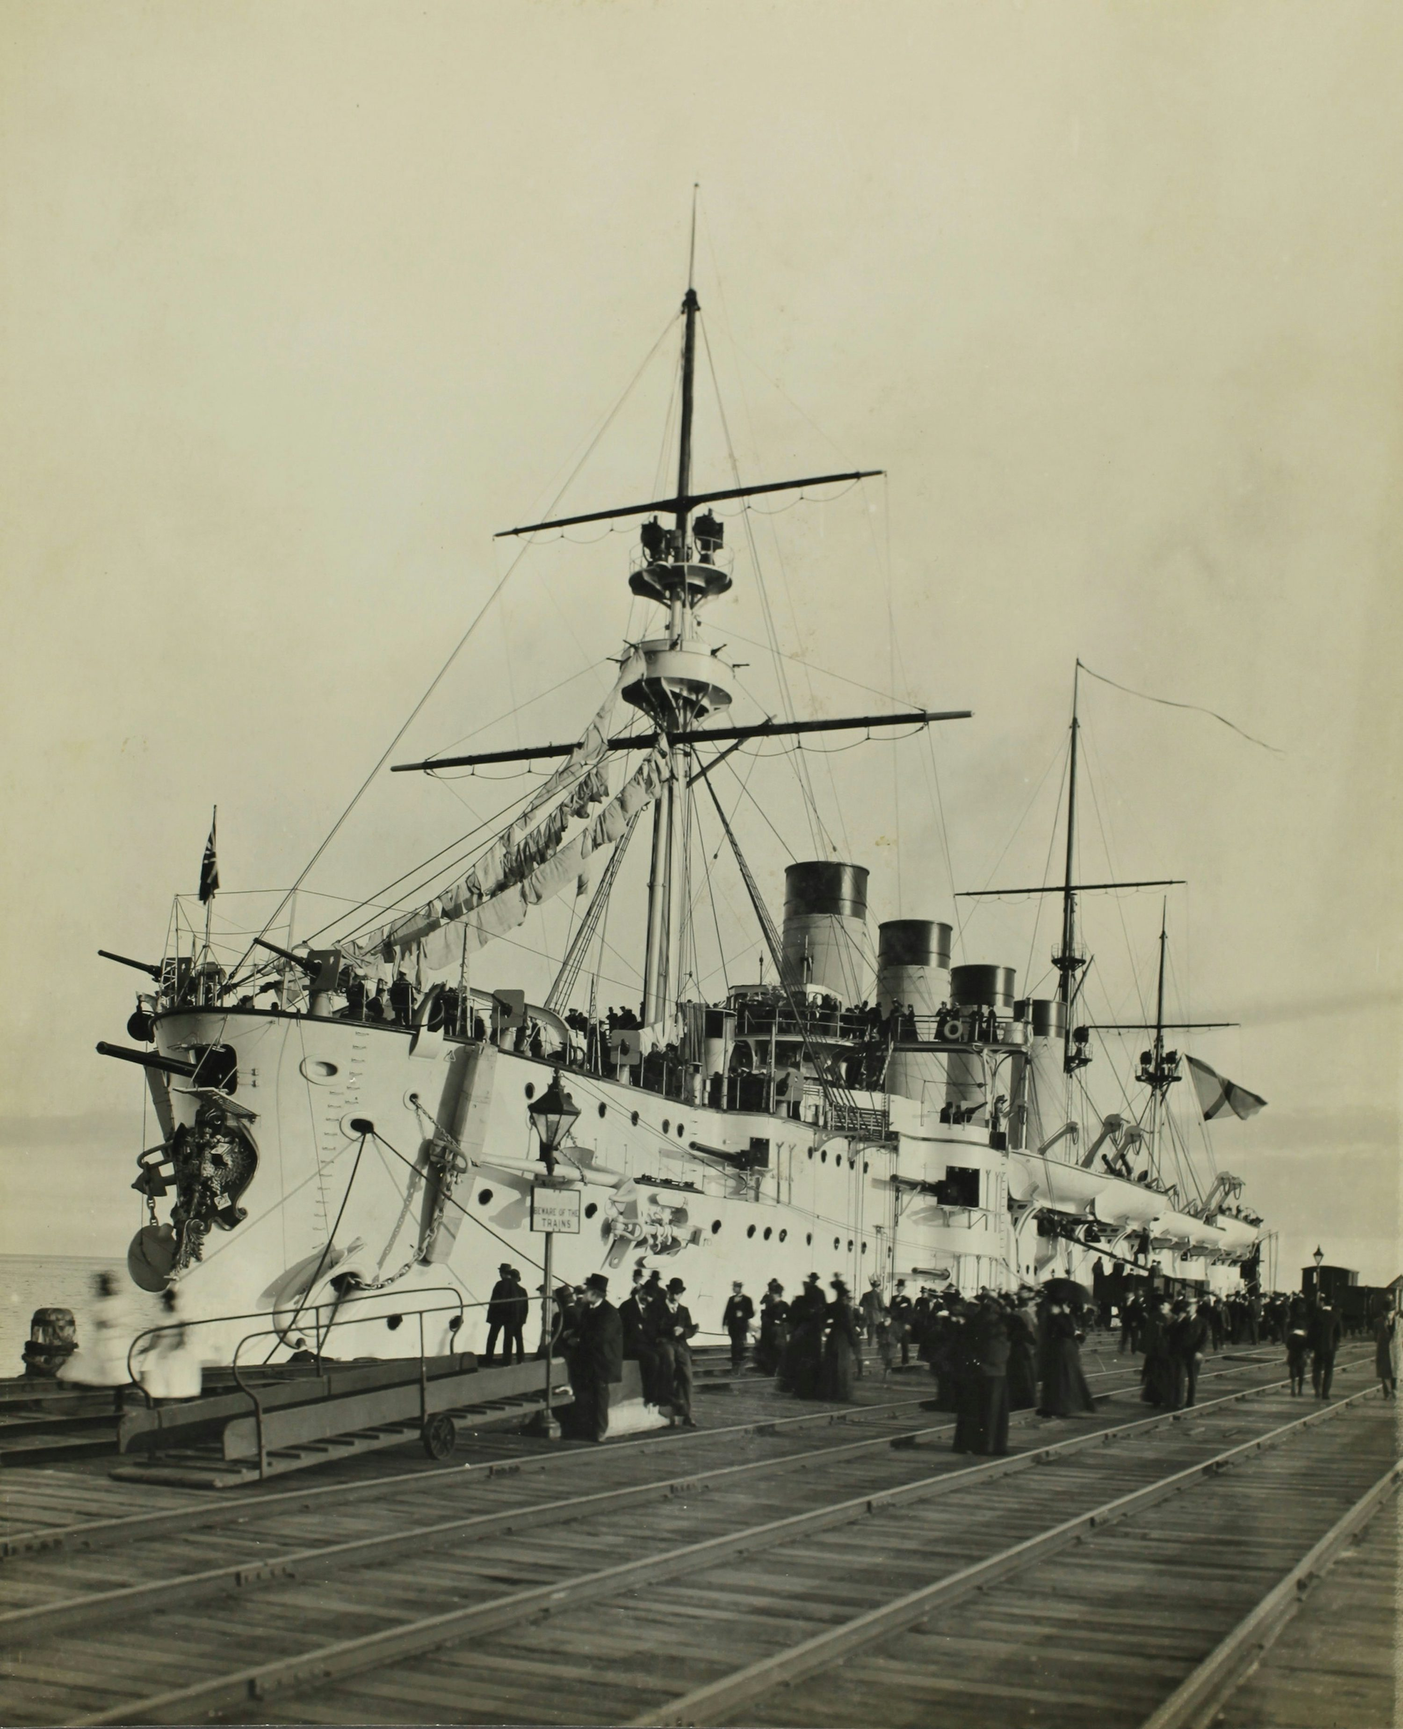
OVERVIEW
On April 15, 1912, during her maiden voyage, the “unsinkable” RMS Titanic sank after colliding with an iceberg. Unfortunately, there was not enough lifeboats for everyone onboard, resulting in the death of 1502 out of 2224 passengers and crew
Training data contains 891 rows, 12 columns
Contains details such as name, age, gender, and socio-economic class
Goal is to predict survival based on the provided features

Slide 4
MODELLING APPROACH
EDA
Pre-Processing
Model Selection
Model Tuning
Final Model Evaluation
Step 1
Step 2
Step 3
Step 4
Step 5
Examine dataframe, inspect data types, structure, etc.
Determine if any missing values
Visualise relationships between variables
Select relevant features for modelling
Impute missing values
Feature engineering to elucidate more poignant relationships
One hot encoding and standard scaling of relevant variables
Fit various models against training dataset using default hyperparameters
Evaluate using cross-validation scores
Preliminarily select candidate models for tuning
Tune candidate models using Random Search and Grid Search
Evaluate models again using cross-validation scores and select best-performing model
Fit selected model against test dataset
Make predictions and submit test results on Kaggle to obtain result

Slide 5
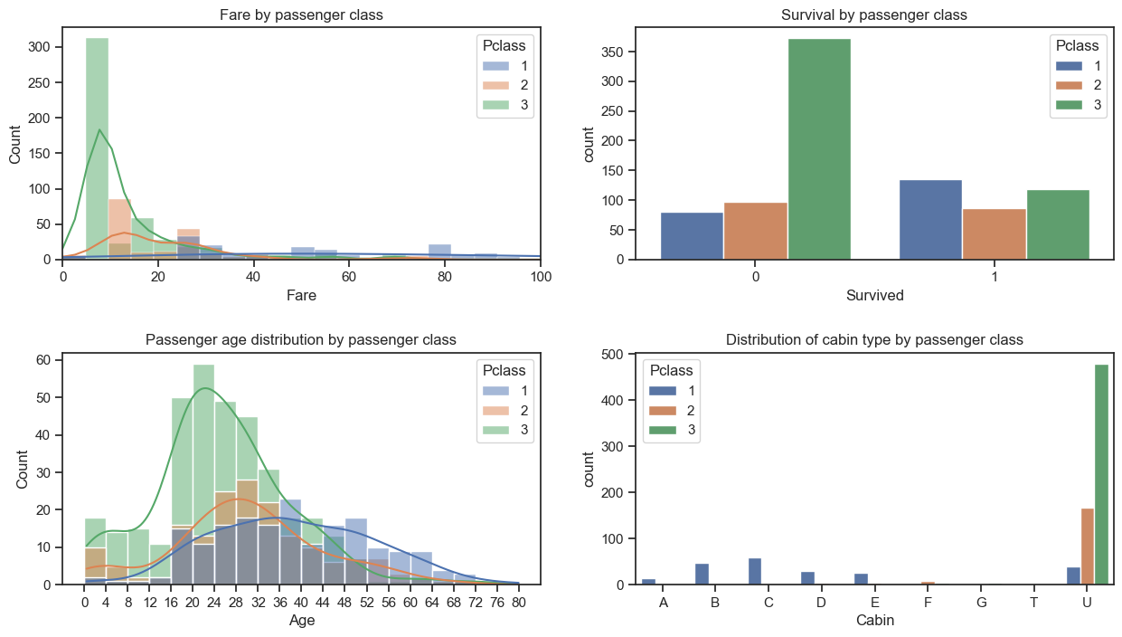
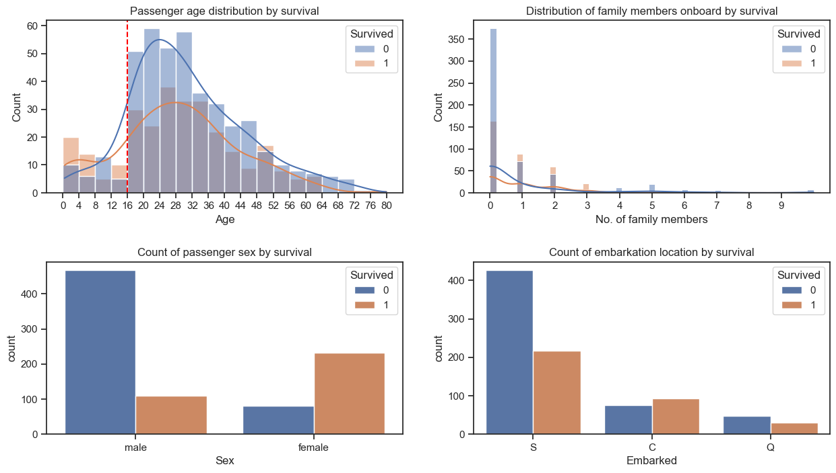
EXPLORATORY DATA ANALYSIS (EDA)
General Trends
Passenger class represents socio-economic status, influencing survival outcomes as reflected in fare, age, and cabin distributions
Passengers in 1st and 2nd class had higher survival rates compared to those in 3rd class
Women and children (≤ 16 years old) prioritised during evacuation, resulting in higher survival
Passengers with 1–3 family members had a relatively better chance of survival
Those who boarded at Cherbourg port (C) also had higher survival rates

Slide 6
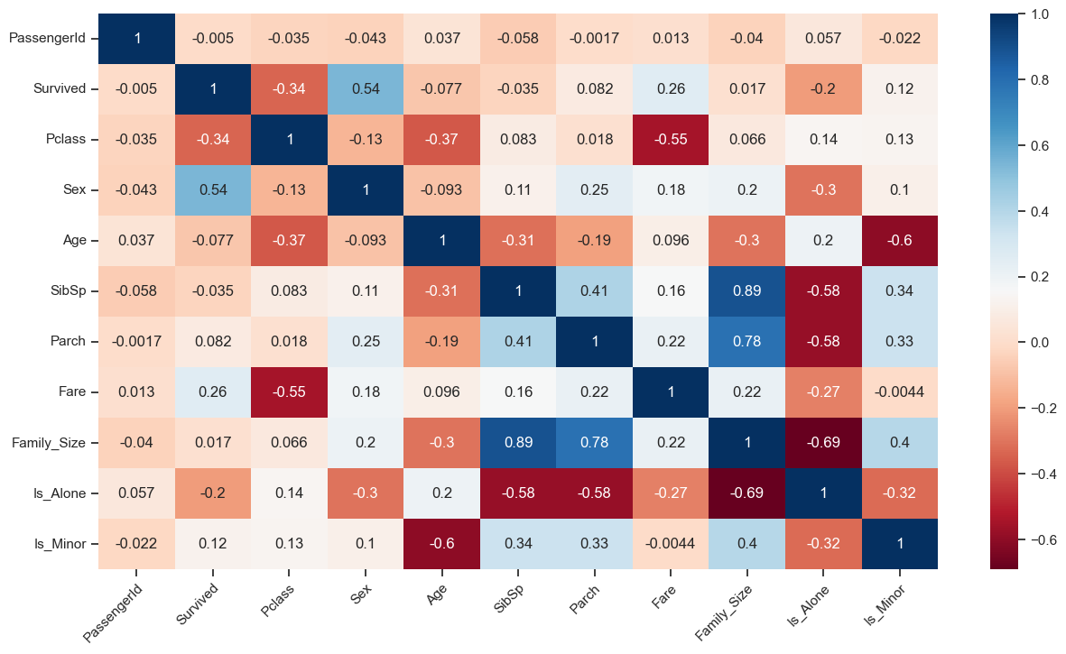
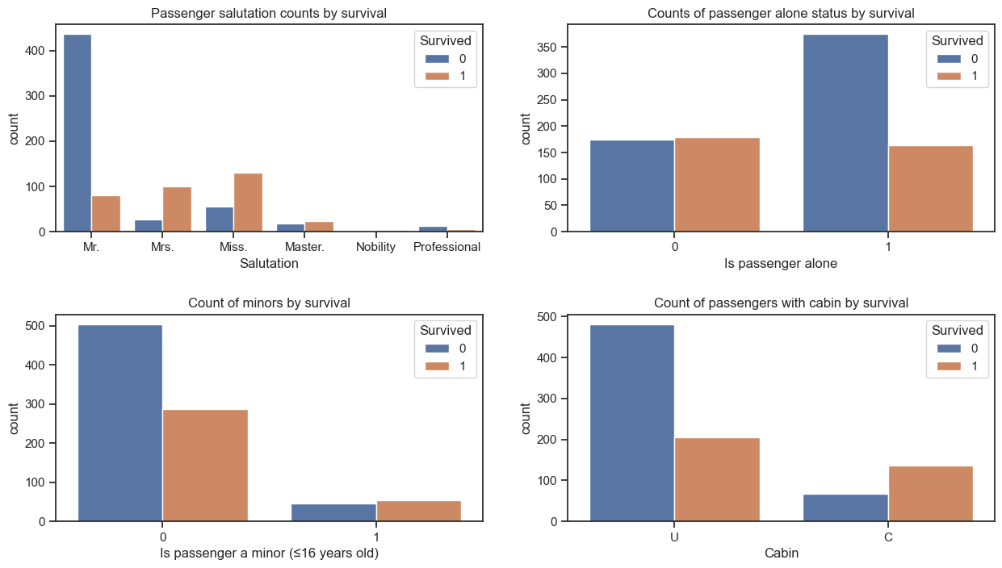
EDA & DATA PRE-PROCESSING
General Trends
Moderate correlation between passenger class, fare, and sex with survival outcome
Age and number of family members (siblings + parents) show minimal correlation with survival unless new features engineered
Feature Engineering
Created the following new features:
Salutation (hints at social status)
Is Alone (whether passenger travelled alone)
Is Minor (whether passenger ≤ 16 years old)
Features leverage existing data to uncover stronger relationships with survival outcome

Slide 7
DATA PRE-PROCESSING
Pipeline
Feature Selector: Selects relevant features for analysis
Group Mean Imputer: Imputes Age and Fare using group means from Pclass (fitted on training data)
Mode Imputer: Fills missing categorical values based on the mode from the training data
Salutation Transformer: Extracts salutations from passenger names
Minor Categorizer: Flags passengers as minors (<16 years)
Family Categorizer: Determines if a passenger is traveling alone
Cabin Classifier: Categorizes cabin data
One-Hot Encoder: Encodes selected categorical variables
Standard Scaler: Scales numerical variables (Fare) using mean and standard deviation from the training dataset

Slide 8
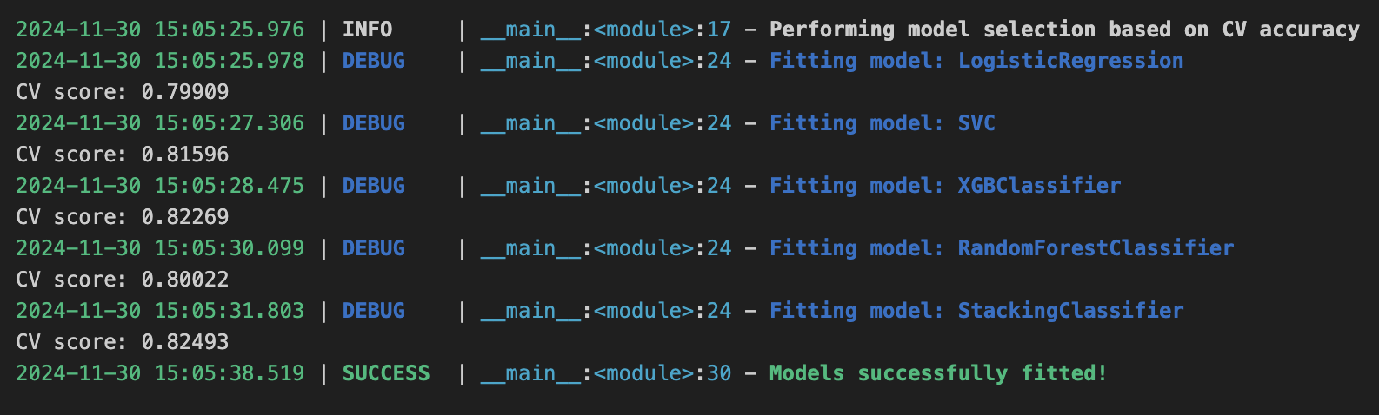
CLASSIFICATION MODELLING
Models Explored
Logistic Regression
Support Vector Classification
XGBoost Classifier
Random Forest Classifier
Stacked Classifier (XGBoost, Random Forest, SVC)
Modelling Process
Chained pre-processing and modelling pipeline to:
Pre-process data
Fit relevant models
Perform 5-fold cross-validation
Evaluate cross-validation scores as first-cut model assessment

Slide 9
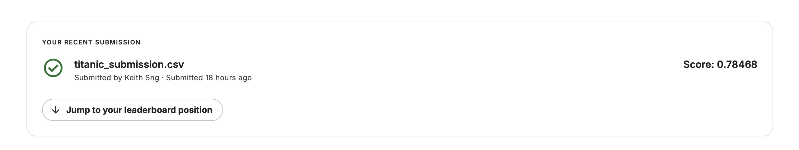
RESULTS
Selected Model
Among candidate models (stacked classifier, XGBoost, SVC, Random Forest), the stacked ensemble classifier performed the best: cross-validation accuracy of 82.2% post-tuning
Performance is significantly better than the naïve model baseline of 62% (majority class)
Stacked ensemble also demonstrates greater robustness compared to individual models
Was chosen as the final model for generating predictions on the test set
Final Prediction
Test accuracy of 78.5%

Slide 10
KING COUNTY, USA
HOUSING PRICE REGRESSION

Slide 11

OVERVIEW
King County in Washington State is home to a dynamic and competitive housing market
With Seattle as its largest city, the county attracts a diverse range of home owners, including billionaires such as Bill Gates and Jeff Bezos, whose presence underscores the wealth of the area
Dataset contains home sales transactions between May 2024 to May 2015, with 21,613 rows and 21 columns
Goal is to predict housing prices using regression models

Slide 12
MODELLING APPROACH
EDA
Pre-Processing
Model Selection
Model Tuning
Final Model Evaluation
Step 1
Step 2
Step 3
Step 4
Step 5
Examine dataframe, inspect data types, structure, etc.
Determine if any missing values
Visualise relationships between variables
Train-test split (80-20)
Select relevant features for modelling
Feature engineering to elucidate more poignant relationships
One hot encoding and standard scaling of relevant variables
Fit various models against training dataset using default hyperparameters
Evaluate using cross-validation RMSE and R² scores
Select candidate model for tuning
Tune candidate model using Grid Search
Fit tuned model against test dataset
Make predictions and evaluate model performance

Slide 13
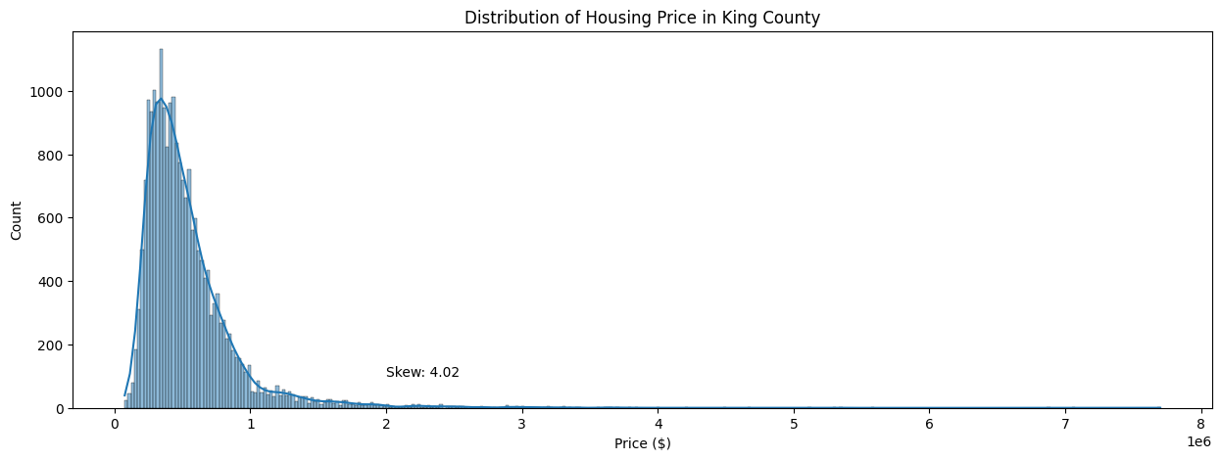
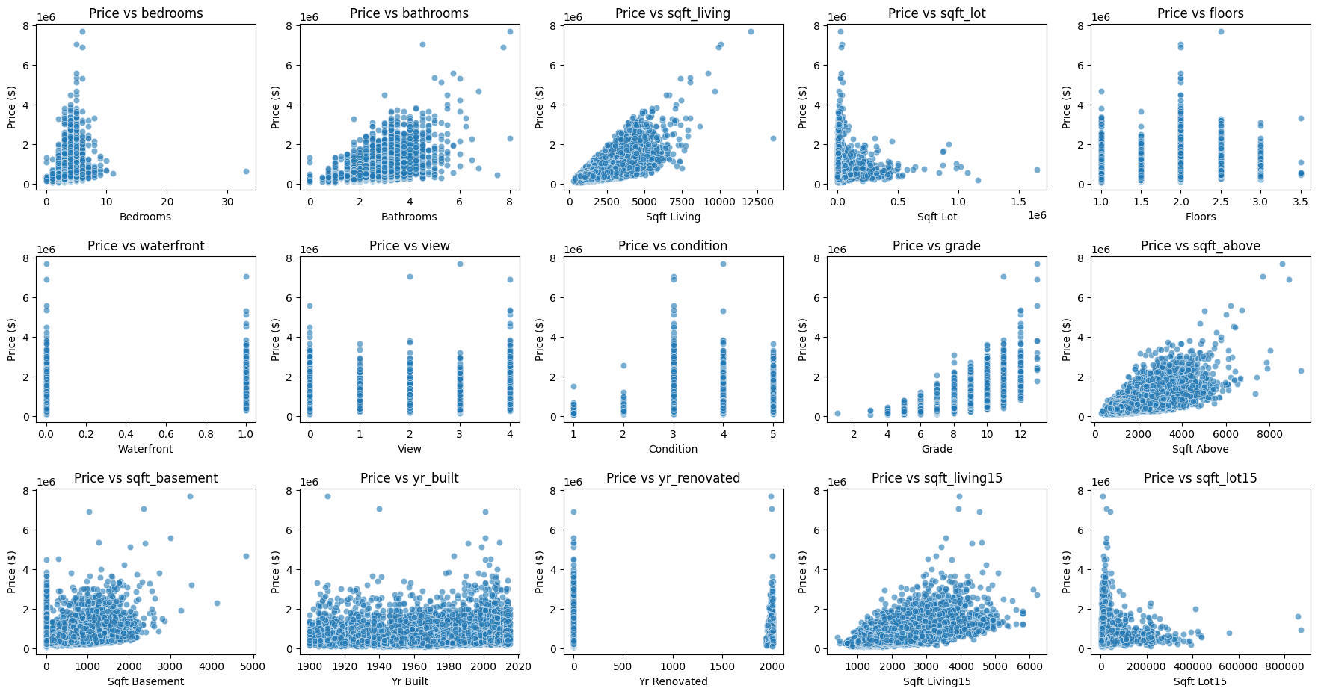
EXPLORATORY DATA ANALYSIS (EDA)
General Trends
Right-skew in housing prices is observed as mean > median, suggesting the presence of outliers
Appears that the features the following features have positive correlation with price:
Number of bathrooms
Area of living space, above-ground area, and basement in sqft
Average living and land area of the nearest 15 neighbours
Building construction grade

Slide 14
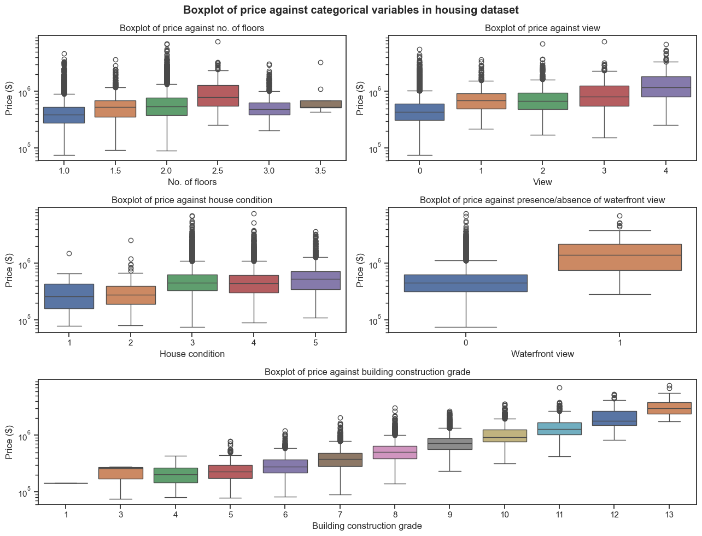
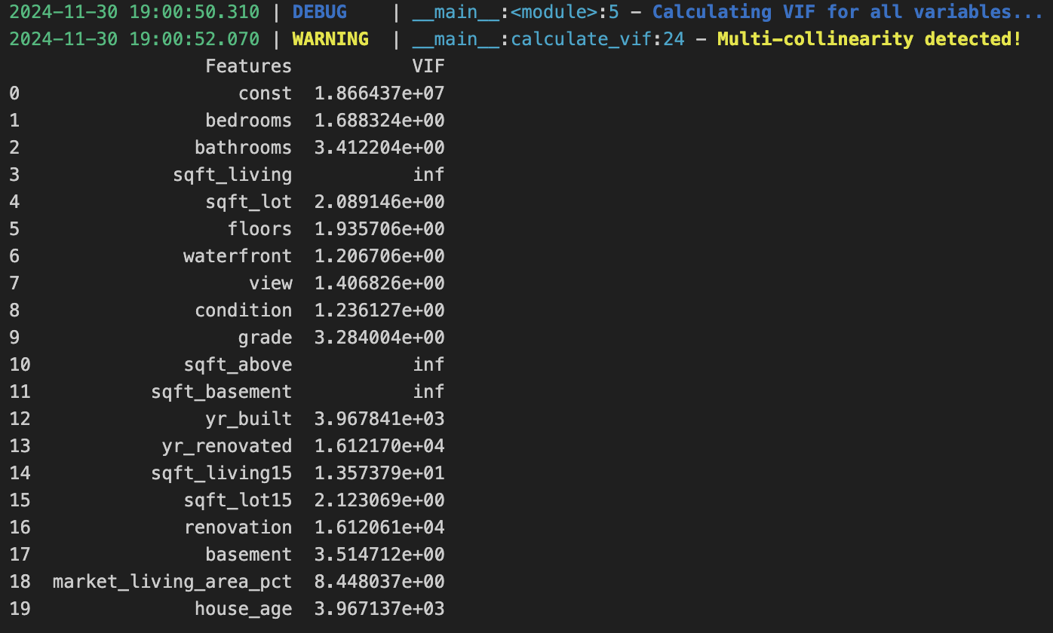
EXPLORATORY DATA ANALYSIS (EDA)
General Trends
Median housing price increases with floors up to 2.5 but decreases for higher floors
Housing price generally increase with better views, waterfront properties, and higher construction grades
Multi-collinearity exists between certain variables within dataset (VIF ≥ 5)

Slide 15
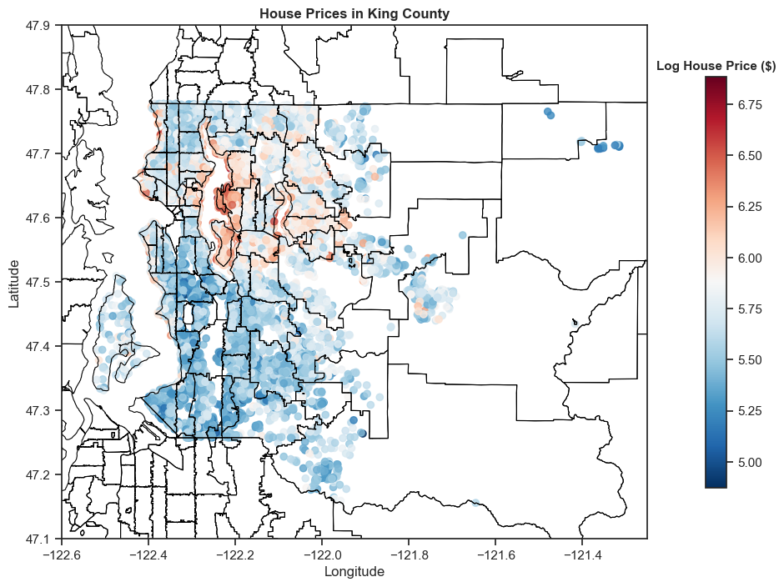
EXPLORATORY DATA ANALYSIS (EDA)
General Trends
Geospatial details for each house based on its zipcode were appended using online datasets to enrich the analysis
Latitude and longitude data were plotted alongside the county map to visualise the spatial distribution of housing prices
The priciest homes were concentrated in Medina and Mercer Island, which are known for housing some of the world’s wealthiest individuals such as Jeff Bezos and Bill Gates

Slide 16
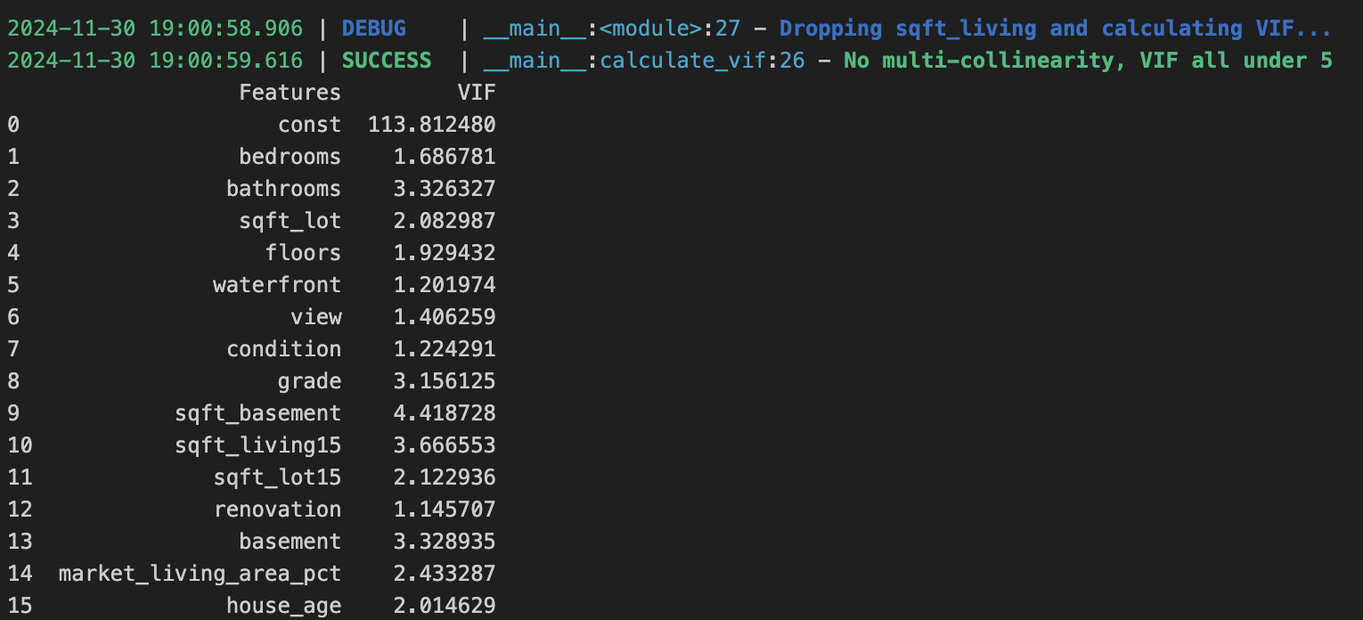
EDA & DATA PRE-PROCESSING
Feature Engineering
Created the following features:
Renovation indicator (whether house was renovated)
Basement indicator (whether house has basement)
Relative house size (size of house relative to the average of the nearest 15 neighbours)
House age (age of house as of date of sale)
City (based on house zipcode)
Multi-Collinearity Checks
Variables rechecked for multi-collinearity after feature engineering (VIF < 5)
Variables removed:
Year built
Year renovated
Above-ground area (sqft)
Living area (sqft)

Slide 17
DATA PRE-PROCESSING
Pipeline
Log-Transformation: Applied to the response variable (price) to normalise its distribution and minimise influence of outliers
Feature Selector: Selects relevant features for analysis
Standard Scaler: Scales numerical variables using mean and standard deviation from the training dataset
One-Hot Encoder: Encodes selected categorical variables (city)

Slide 18
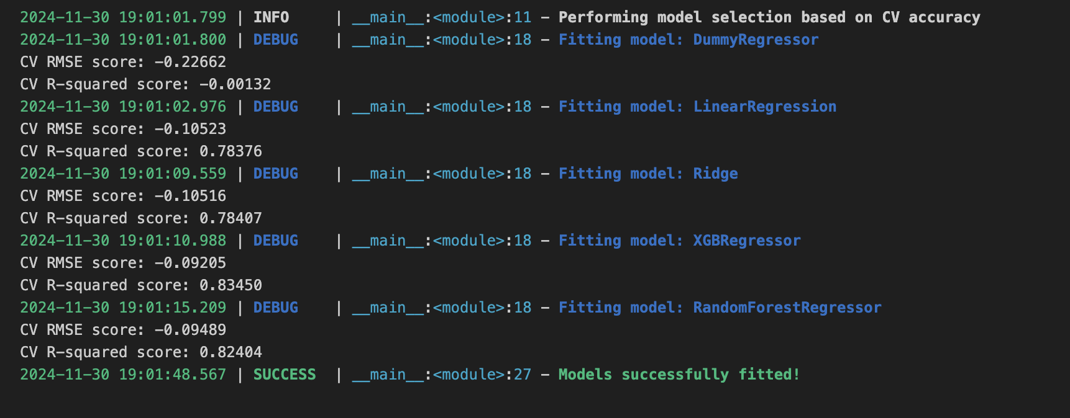
CLASSIFICATION MODELLING
Models Explored
Dummy Regressor (mean)
Linear Regression
Ridge Regression
XGBoost Regressor
Random Forest Regressor
Modelling Process
Chained pre-processing and modelling pipeline to:
Pre-process data
Fit relevant models
Perform 10-fold cross-validation
Evaluate cross-validation scores as first-cut model assessment

Slide 19
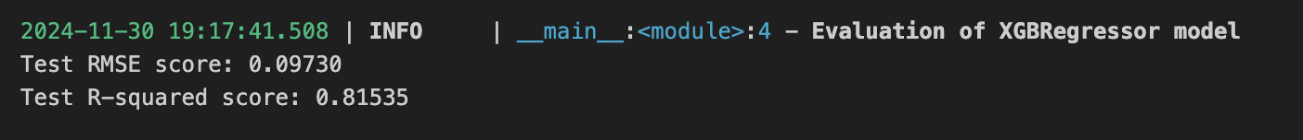
RESULTS
Selected Model
XGBoost Regressor performed the best, with the tuned model returning the lowest RMSE of 0.09271 and highest R² of 82.3%
Model performed significantly better than a dummy regressor predicting the mean with an RMSE of 0.2262 and R² of 0%
Final Prediction
Test RMSE of 0.0973 and R² of 81.5%

Slide 20

FUTURE WORK
Feature Engineering
Robust Feature Selection
Explore Other Models
Beyond leveraging existing features, future work can explore at creating new feature to uncover deeper patterns and trends.
For example, predicting titanic survivorship based on family tree-based survival, using passengers’ last names to identify families and infer survival outcomes. Alternatively, predicting King County housing prices based on average distance to nearby amenities.
In addition to correlation or variance inflation factor (VIF)-based feature selection, other techniques can be utilised to refine feature sets and improve model performance.
For example, Recursive Feature Elimination (RFE), a method that recursively removes the least important features based on the chosen model’s performance, or feature importance from Random Forest where features are ranked based on their contribution to reducing impurity in decision trees.
Experiment with other models such as decision trees or ensemble methods AdaBoost to potentially yield better results
Ingoude Company

